Slide 1
Computer Organization and Assembly Language Lecture 6

Slide 2
Agenda
Today’s topics:
Designing a Computer
Defining ISA
Instruction Pipelining
MIPS Instruction Set
Design Principles

Slide 3
Designing a Computer
Input
Control
Datapath
Memory
Central Processing
Unit (CPU)
or “processor”
Output
FIVE PIECES OF HARDWARE

Slide 4
Defining ISA
What is instruction set architecture (ISA)?
ISA
Defines registers
Defines data transfer modes (instructions) between registers, memory and I/O
There should be sufficient instructions to efficiently translate any program for machine processing
Next, define instruction set format – binary representation used by the hardware
Variable-length vs. fixed-length instructions

Slide 5
Types of ISA
Complex instruction set computer (CISC)
Many instructions (several hundreds)
An instruction takes many cycles to execute
Example: Intel Pentium
Reduced instruction set computer (RISC)
Small set of instructions (typically 32)
Simple instructions, each executes in one clock cycle – REALLY? Well, almost.
Effective use of pipelining
Example: ARM (Advanced RISC Machine)

Slide 6
Instruction Pipelining
An instruction pipeline receives sequential instructions from memory while prior instructions are implemented in other portions.
Pipeline processing can be seen in both the data and instruction streams.
To perform tasks such as fetching, decoding and execution of instructions, most digital computers with complicated instructions would require an instruction pipeline.

Slide 7
Instruction Pipelining
In general, each and every instruction must be processed by the computer in the following order:
1. Fetching the instruction from memory
2. Decoding the obtained instruction
3. Calculating the effective address
4. Fetching the operands from the given memory
5. Execution of the instruction
6. Storing the result in a proper place

Slide 8
Instruction Pipelining
Each step is carried out in its own segment, and various segments may take different amounts of time to process the incoming data.
Furthermore, there are occasions when multiple segments request memory access at the very same time, requiring one segment to wait unless and until the memory access of another is completed.
If the instruction cycle is separated into equal-length segments, the organization of an instruction pipeline will become much more efficient.

Slide 9
Instruction Pipelining
A four-segment instruction pipeline unifies two or more distinct segments into a single unit. For example, the decoding of the instruction and the calculation of the effective address can be merged into a single segment
Segment 1:
Instruction Fetch using FIFO
Segment 2:
Decode instruction and effective address calculation
Segment 3:
Fetch operands
Segment 4
Instruction execution

Slide 10
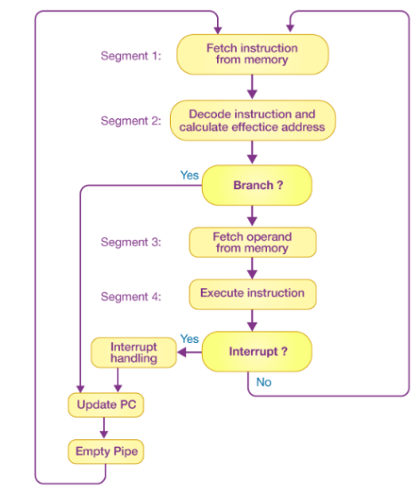

Slide 11
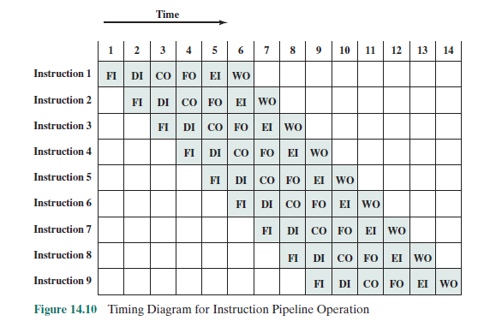

Slide 12
Pipelining of RISC Instructions
Fetch
Instruction
Decode
Opcode
Fetch
Operands
Execute
Operation
Store
Result
Although an instruction takes five clock cycles,
one instruction can be completed every cycle.

Slide 13
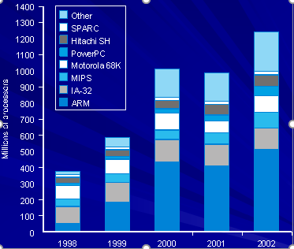
Growth of Processors
Language of the Machine
We’ll be working with the MIPS instruction set architecture
similar to other architectures developed since the 1980's
Almost 100 million MIPS processors manufactured in 2002
used by NEC, Nintendo, Cisco, Silicon Graphics, Sony, …
2004 © Morgan Kaufman Publishers

Slide 14
MIPS Instruction Set (RISC)
Instructions execute simple functions.
Maintain regularity of format – each instruction is one word (4 bytes), contains opcode and arguments.
Minimize memory accesses – whenever possible use registers as arguments.
Three types of instructions:
Register (R)-type – only registers as arguments.
Immediate (I)-type – arguments are registers and numbers (constants or memory addresses).
Jump (J)-type – argument is an address.

Slide 15
MIPS Arithmetic Instructions
All instructions have 3 operands
Operand order is fixed (destination first) Example: C code: a = b + c; MIPS ‘code’: add a, b, c “The natural number of operands for an operation like addition is three… requiring every instruction to have exactly three operands “no more than, no less than”, conforms to the philosophy of keeping the hardware simple”
2004 © Morgan Kaufman Publishers

Slide 16
MIPS Arithmetic Instructions
Suppose we want to place sum of four variables b,c,d and e in variable a, we must have to perform this operation by writing set of MIPS instructions:
MIPS code
add a,b,c #the sum of b and c is placed in a
add a,a,d # the sum of b, c and d is now in a
add a,a,e # the sum of b,c,d and e is now in a
Thus it takes three instructions to add four variables

Slide 17
Arithmetic Instr. (Continued)
Design Principle 1: simplicity favors regularity.
This means that the MIPS instruction format is the same for all instructions. Each instruction begins with an opcode that tells the machine what to do, followed by one to three operand symbols.
Example C code: a = b + c + d; MIPS code: add a, b, c add a, a, d
C code: f=(g+h)-(i+j)
MIPS code: add t0,g,h
add t1,i,j
sub f,t0,t1

Slide 18
Operands of the Computer Hardware
Unlike programs in high level language, the operands of arithmetic instructions are restricted.
Operands must be from a limited numbers of special locations built directly in hardware called registers
In MIPS, 32 registers provided
Each register contains 32 bits (size of each register is 32bits)
Means 4 bytes (1 word)
One major difference between the variable of a programming language and registers is the limited number of registers

Slide 19
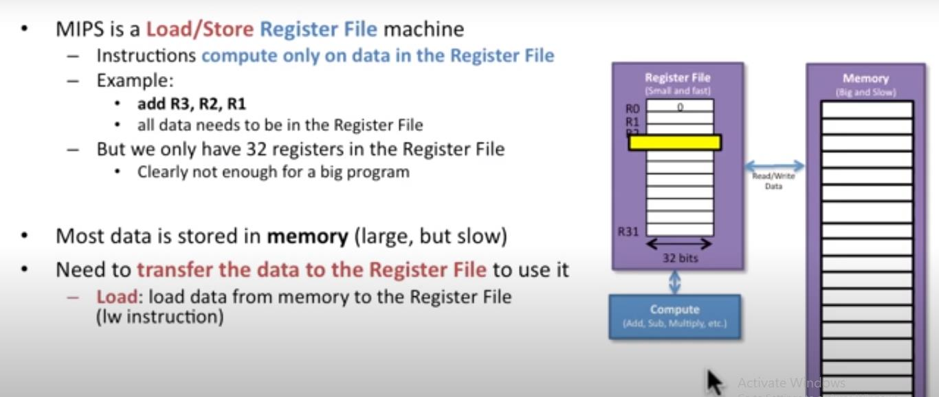
Registers vs. Memory
Arithmetic instructions operands must be registers
32 registers provided
Compiler associates variables with registers.

Slide 20
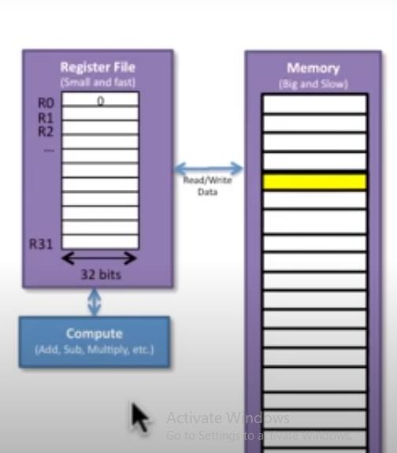
Registers vs Memory
Store: store data to the memory from the register file (sw instruction)
Hence, MIPS is load/store register file machine

Slide 21

Design Principle 2
“Smaller is faster”
fewer bits to read, move, & write
– use/reuse the register file instead of memory
Thus, in proper MIPS code, the preceding example would become:
In the preceding example, note that we have temporary variables t0 and t1, as well as input/result variables f, g, h, i, and j.
In MIPS, we also have eight temporary registers labelled $t0 through $t7 and nine s-registers labelled $s0 through $s8.
The s-registers can be thought of as containing data that are typically stored in C variables.

Slide 22
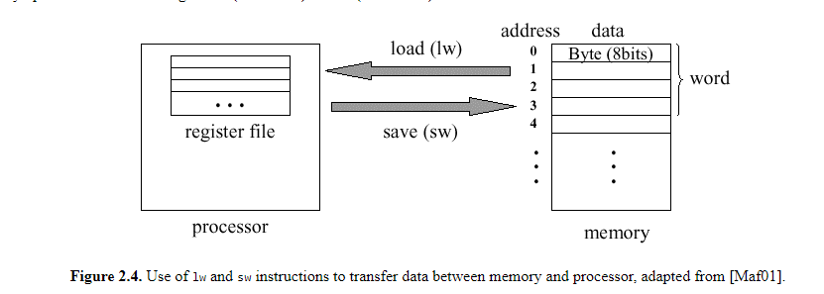
MIPS Memory Organization
Memory contains instructions and data specific to a given program. Instructions are fetched automatically by control, while data is transferred explicitly between the memory and processor.
Figure 2.4 shows an example of memory operations in MIPS using the lw (load word) and sw (store word) instructions.

Slide 23
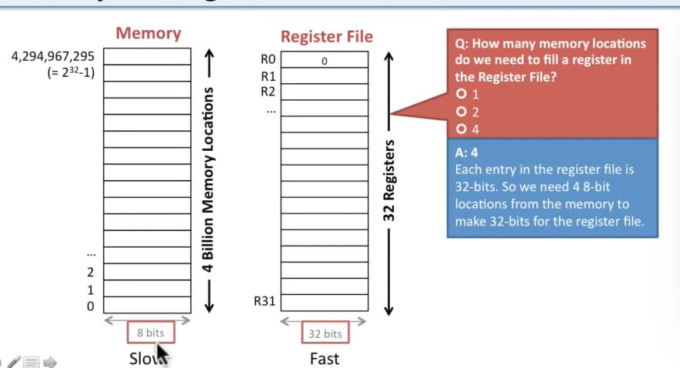
Memory and Register File

Slide 24
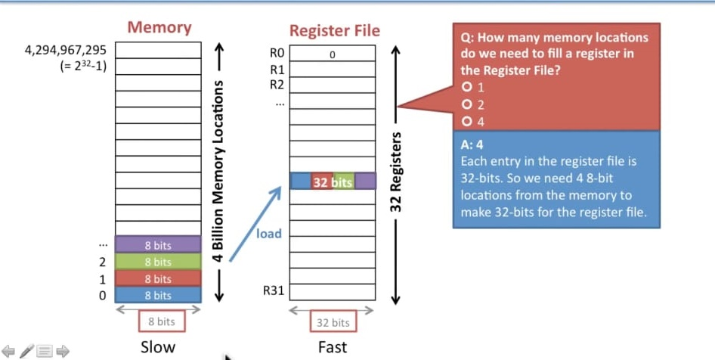
Memory and Register File

Slide 25
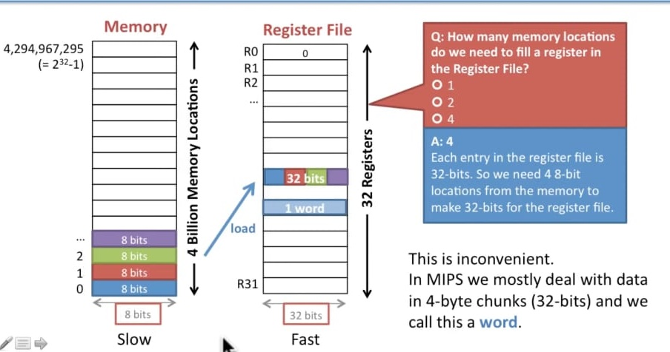
Memory and Register File

Slide 26
Memory Organization
Bytes are nice, but most data items use larger "words"
For MIPS, a word contains 32 bits or 4 bytes.
word addresses
Addresses in MIPS range from 0 (which points to data in the part of memory denoted as M[0]) up to 4,294,967,292 (referenced data is written as M[2³²]). Thus, all addresses are 32 bits long, so 2³⁰ 32-bit (four-byte) words are stored in MIPS memory.
0
4
8
12
.
32 bits of data
Registers hold 32 bits of data
Use 32 bit address
32 bits of data
32 bits of data
32 bits of data
32 bits of data
...

Slide 27
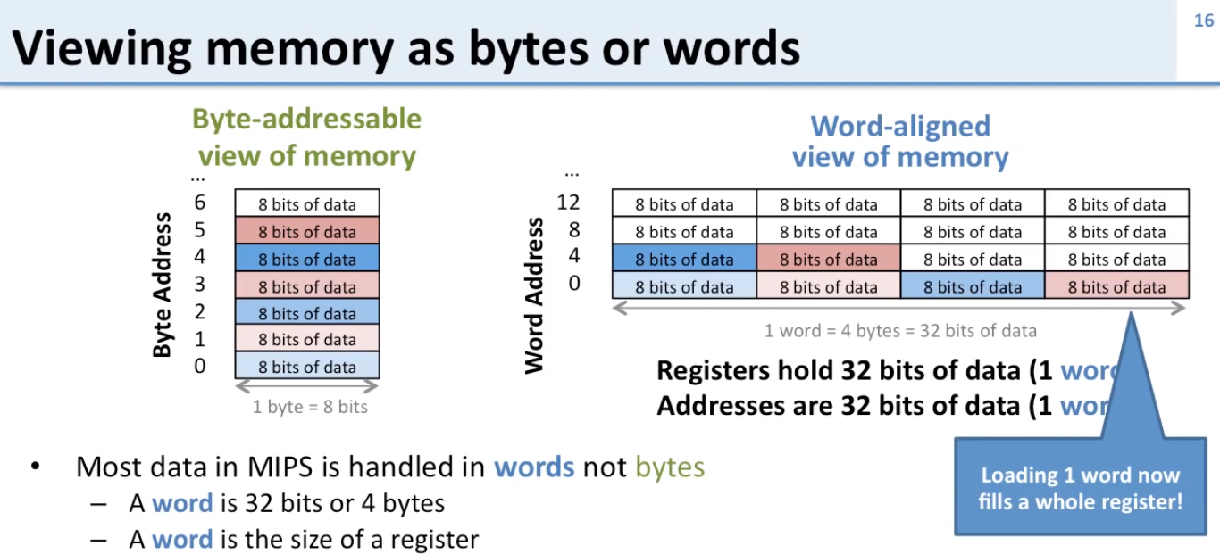

Slide 28
MIPS Memory Organization
The MIPS architecture requires words to be aligned in memory; 32-bit words must start at an address that is divisible by 4.
0, 4, 8 and 12 are valid word addresses
1, 2, 3, 5, 6, 7, 9, 10 and 11 are not valid word addresses
Unaligned memory accesses result in a bus error

Slide 29
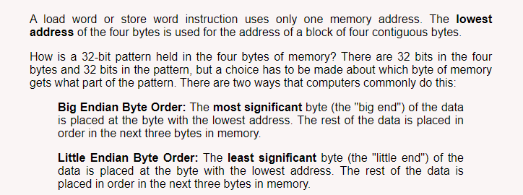
Big Endian and Little Endian

Slide 30
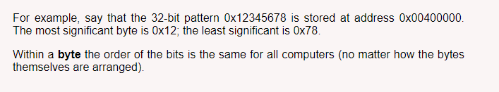
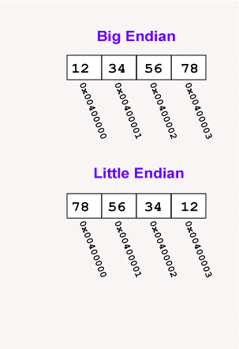

Slide 31
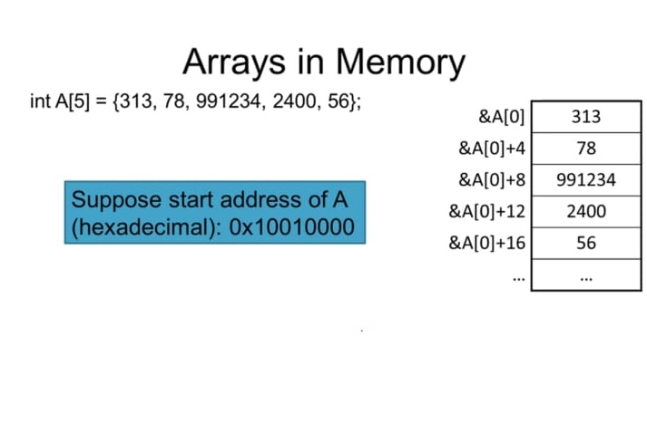
Example

Slide 32
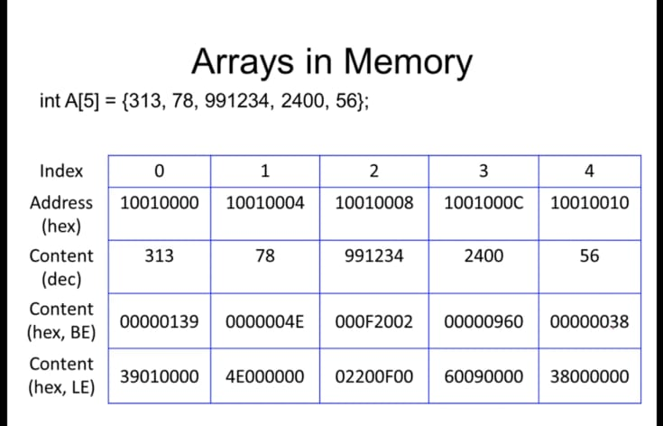

Slide 33
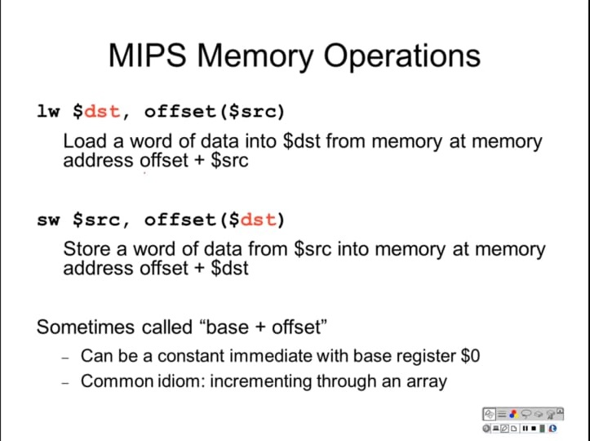

Slide 34
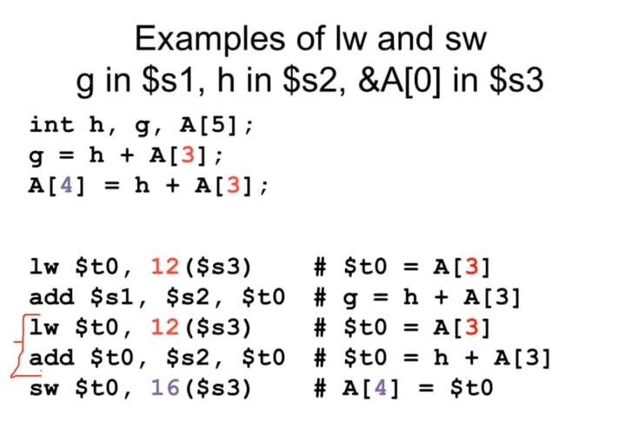

Slide 35
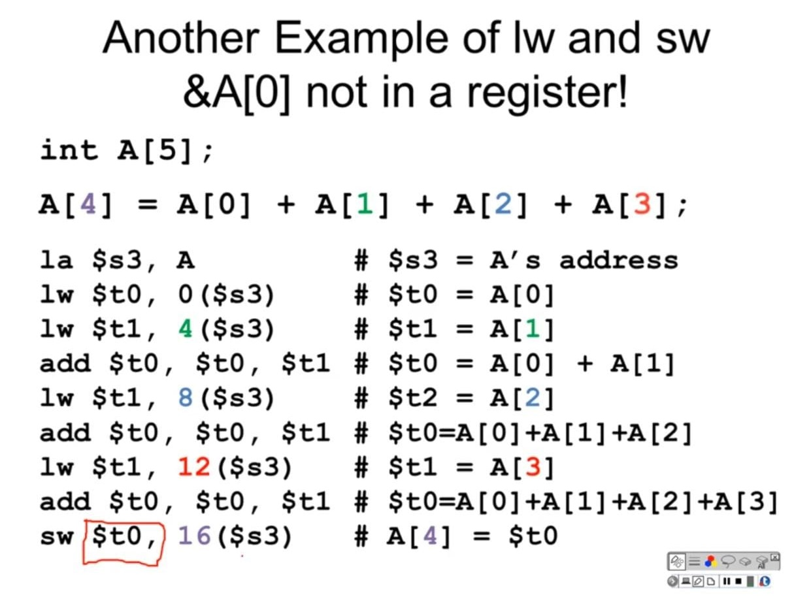

Slide 36
Instructions
Transfer instructions:
Load and store instructions
Only load/store instructions can access data in memory.
Example: C code: A[12] = h + A[8]; MIPS code: lw $t0, 32($s3) #addr of A in reg s3
add $t0, $s2, $t0 #h in reg s2 sw $t0, 48($s3)
Can refer to registers by name (e.g., $s2, $t2) instead of number
Store word has destination last
Remember arithmetic operands are registers, not memory! Can’t write: add 48($s3), $s2, 32($s3)

Slide 37
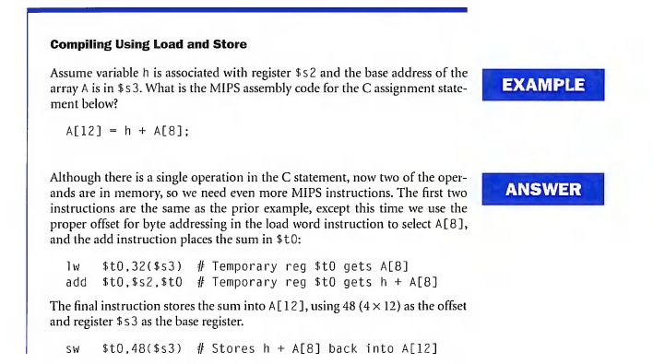

Slide 38
Constants or Immediate Operands
Design Principle 3- “Make the common case fast”
Using only the instructions we have seen so far, we would have to load a constant from memory to use one. (The constants would have been placed in memory when the program was loaded.)
For example, to add the constant 4 to register $s3, we could use the code
lw $t0, AddrConstant4($s1) # $t0 = constant 4
add $s3,$s3,$t0 # $s3 = $s3 + $t0 ($t0 == 4)
Assuming that $s1+ AddrConstant4 is the memory address of the constant 4.

Slide 39
An alternative that avoids the load instruction is to offer versions of the arithmetic instructions in which one operand is a constant.
This quick add instruction with one constant operand is called add immediate or addi. To add 4 to register $s3, we just write
addi $s3,$s3,4 # $s3 = $s3 + 4

Slide 40
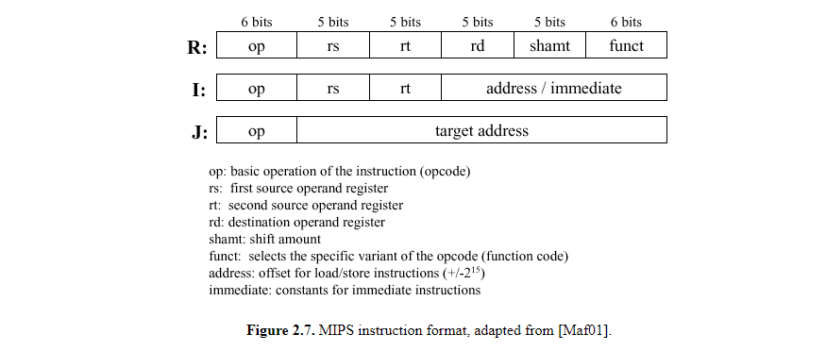
MIPS Instruction format
Following are R-type, I-type and jump instructions

Slide 41
So Far We’ve Learned
MIPS — loading words but addressing bytes — arithmetic on registers only
Instruction Meaning add $s1, $s2, $s3 $s1 = $s2 + $s3 sub $s1, $s2, $s3 $s1 = $s2 – $s3 lw $s1, 100($s2) $s1 = Memory[$s2+100] sw $s1, 100($s2) Memory[$s2+100] = $s1

Slide 42
Design principle 4
“Good design demands good compromises”

Slide 43
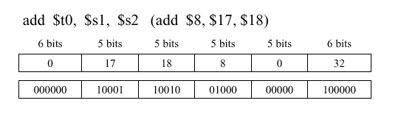
Instruction Format
Instructions, like registers and words of data, are also 32 bits long
Example: add $t0, $s1, $s2
registers are numbered, $t0=8, $s1=17, $s2=18
Instruction Format:
opcode rs rt rd shamt funct
2004 © Morgan Kaufman Publishers

Slide 44
Instruction Format
Consider the load-word and store-word instructions,
What would the regularity principle have us do?
New principle: Good design demands a compromise
Introduce a new type of instruction format
I-type for data transfer instructions
other format was R-type for register
Example: lw $t0, 32($s3) #temporary reg $t0 gets A[8]
Where's the compromise?
35 18 9 32
opcode rs rt constant or address
6 bits | 5 bit | 5bit | 16bit

Slide 45
Instruction Format
Here, 19 (for $s3) is placed in the rs field, 8 (for $t0) is placed in the rt field and 32 is placed in address field
Example: lw $t0, 32($s3) #temporary reg $t0 gets A[8]
Where's the compromise?
Multiple formats complicate the hardware
35 19 8 32
opcode rs rt 16 bit number

Slide 46
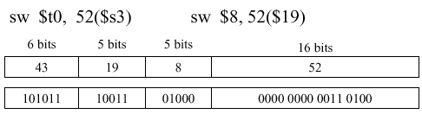
Instruction Format
Store word

Slide 47
We can reduce the complexity!!!
We can reduce the complexity by keeping the formats similar
The first three fields of R-type and I-type are the same size and have the same names
The length of fourth field in I-type is equal to the sum of the lengths of last three fields of R-type

Slide 48
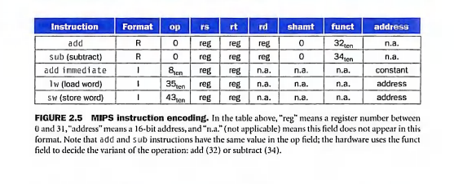
Figure 2.5 shows the numbers used in each field for the MIPS instructions covered here

Slide 49
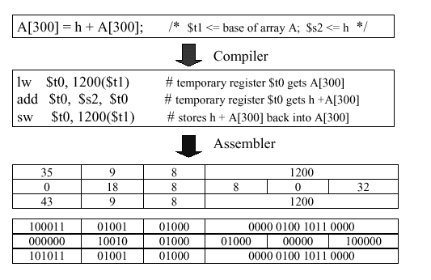
Another Example
Given the high level statement,
A[300]=h+A[300], the following translation sequence holds

Slide 50
Stored Program Concept
Today’s computers are built on two key principles
Instructions are represented as numbers
Programs are stored in memory to be read or written, just like numbers
These principles lead to the “stored program” concept

Slide 51
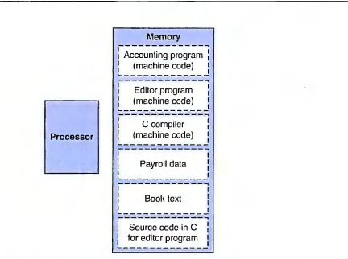
Stored Program Concept
Fetch and Execute Cycles
Instructions are fetched and put into a special register
Opcode bits in the register "control" the subsequent actions
Fetch the “next” instruction and continue
2004 © Morgan Kaufman Publishers

Slide 52
Logical Operations
In MIPS, a logical constant is expressed as a vector of 32 ones and zeroes, not as an integer number.
This leads to the practice of bitwise logical operations that operate in parallel upon a vector of Boolean numbers, for example:
(0010 0001 0100) = (0010 0001 0110) and (1010 0011 0101)
In MIPS instructions and and or, the operands are registers, and the R-format instruction is used (similar to the add instruction).
In contrast, MIPS instructions andi and ori have operands that are immediates, and the I-format instruction is used. (similar to addi instruction)

Slide 53
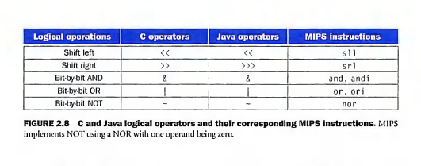

Slide 54
AND Operation
AND is a bit by bit operation that leaves a 1 in the result only of both bits of the operands are 1.
For example if register $t2 contains
(0000 0000 0000 0000 0000 1101 1100 0000)_{two}
And register $t1 contains
(0000 0000 0000 0000 0011 1100 0000 0000)_{two}
Then after executing the MIPS instruction
and $t0,$t1,$t2 #$t0=$t1+$t2 and the value of $t0 would be:
(0000 0000 0000 0000 0000 1100 0000 0000)_{two}

Slide 55
OR Operation
A logical bit-by-bit operation with two operands that results a 1 if any of the operand is 1.
or $t0,$t1,$t2 # reg $t0=reg $t1 | reg $t2
??? What is the answer of OR operation performed on previous values??

Slide 56
NOT and NOR
A logical bit-by-bit operations with one operand that inverts the bits;that is, it replaces every 1 with a 0 and every 0 with a 1.
NOT takes one operand and places a 1 in the result if one operand bit is a 0 and vice versa.
In keeping with the three address format, the designers of MIPS decided to include the instruction NOR (not OR) instead of NOT,
nor $t0,$t1,$t2

Slide 57
Policy of Register Usage (Conventions)
Register 1 ($at) reserved for assembler, 26-27 for operating system

